Slide 1


Welcome to the
American Board of Pathology
Resident Orientation
Revised 8/23

Slide 2
American Board of Pathology (ABPath)

Slide 3
American Board of Pathology (ABPath)
ABPath - BOARD CERTIFICATION of Pathologists
ACGME - ACCREDITATION of Programs

Slide 4
ABPath Principal Activities
Establish
Establish certification standards
Assess
Assess qualifications of those seeking to practice pathology
Conduct
Conduct voluntary primary and subspecialty examinations and award certificates to successful candidates

Slide 5
ABPath Principal Activities cont.
Encourage the Continuing Certification (CC) of those practicing pathology
Participate in review of pathology training programs and support program directors and trainees
Maintain a registry of diplomates
Public reporting of certification status

Slide 6
The ABPath does not:
  confer a license to practice pathology
  delineate who may practice pathology
  define hospital/HCO privileges
  define the scope of practice
  delineate practice standards

Slide 7
ACGME/ABMS Competencies

Slide 8
ABPath Primary Certification
Anatomic and Clinical Pathology
Anatomic Pathology (AP)
Clinical Pathology (CP)
AP/Neuropathology

Slide 9
ABPath Subspecialty Certification

Slide 10
ABPath Subspecialty Certification

Slide 11
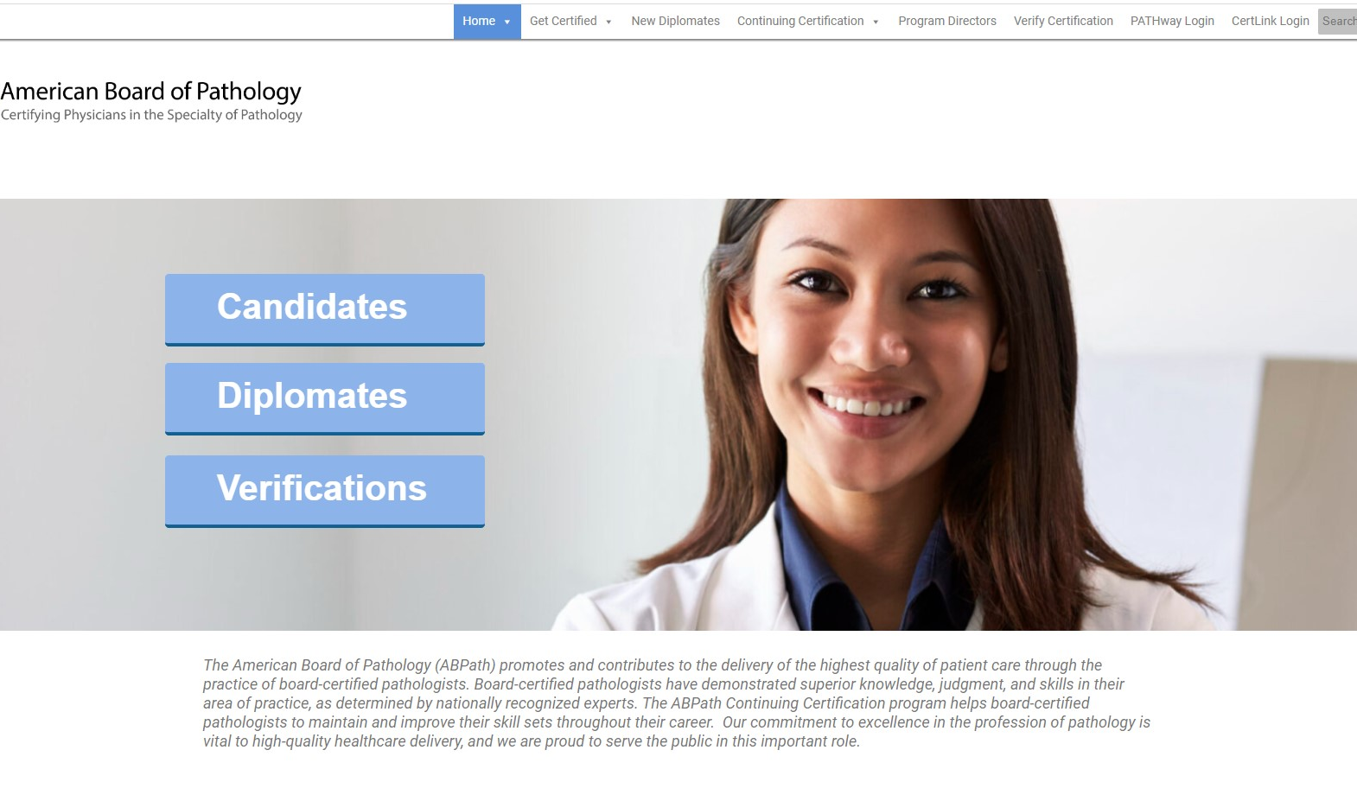

PATHway is your online path to board certification
ABPath’s online system for board certification and the Continuing Certification (CC) Program.
Residents should log in annually to complete the Honor Code, Authorization form and update personal information.
All exam application links are available in PATHway.
PATHway can be accessed from abpath.org.

Slide 12
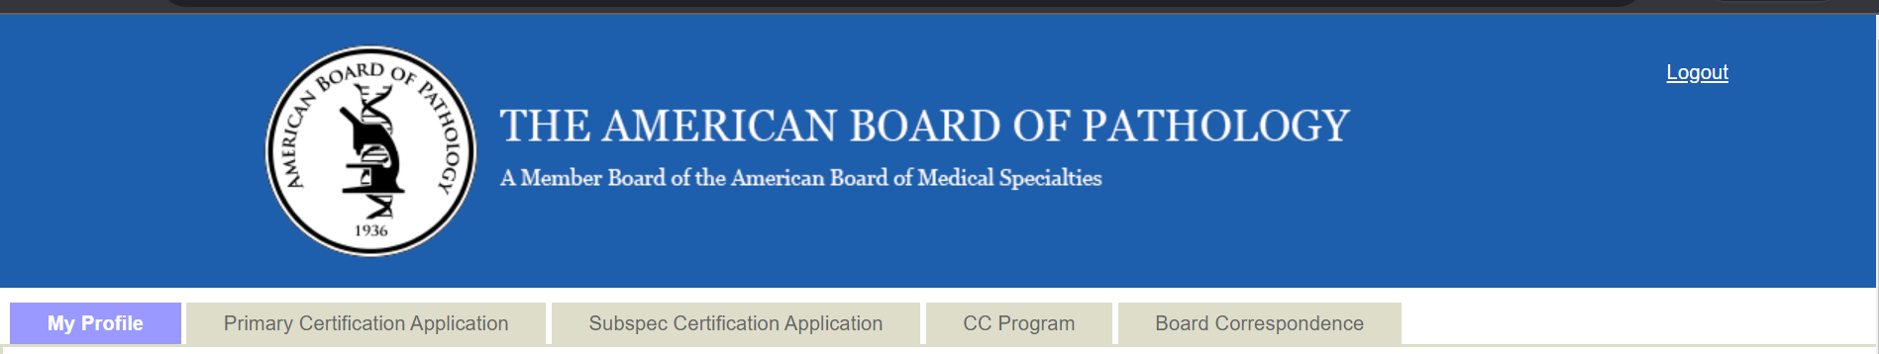
PATHway
My Profile – Your personal information. It is important to keep this information updated for the mailing of your certificate and for correspondence from ABPath. It is recommended to use your personal email.
Primary Certification Application – Important dates, deadlines, primary application/registration links
Subspecialty Certification Application – Important dates, deadlines, subspecialty application/registration links

Slide 13
PATHway (cont.)
CC Program – Continuing Certification Program Reporting and tracking
Board Correspondence – Application/registration tracking, examination results letter, important certification information

Slide 14

Booklet of Information- the complete guide for certification requirements.
The Booklet should be reviewed annually for the latest information on certification requirements and ABPath policy.
The following pages give an overview of the requirements for certification.
Available at abpath.org

Slide 15
Requirements for Primary Certification
Professional Education
  LCME accredited medical school in US or Canada
  AOA accredited osteopathic medical school
  Medical school outside US or Canada acceptable to ABPath

Slide 16
Training Requirements for Primary Certification
AP/CP
48 months full-time training
18 months structured training each in AP and CP
12 months flexible training of AP or CP
AP or CP only
36 months full-time training
24 months structured training in AP or CP
12 months flexible training of AP or CP
May include up to 6 months of research

Slide 17
Requirements for Primary Certification
  Current, full and unrestricted license
  An institutional, training, or temporary license is not acceptable
  If applying for license but not yet received:
    Copy of letter or email from licensing board and
    Documentation of having passed USMLE Step 3
  Exam results are withheld until full license received
Medical License

Slide 18
Autopsy Requirement for Certification
Minimum 30 cases; must show competency
Shared - No limit, only two residents may share.
Limited – Limit of five including single organ, cannot be shared.
Fetal - Limit of five. Two can be macerated fetuses.
Must upload the ACGME autopsy log.
Complete autopsy requirements are available in the Booklet of Information.

Slide 19
Assessment Requirements for Primary Certification
Successful completion of AP and/or CP examinations administered by ABPath
Must pass both AP and CP for combined certification

Slide 20
Time Away from Training
ABPath Policy
  Residents can take up to 12 months away from training for any reason with approval from Program Director
  Fellowships do not count as time away
  Training duration must average 48 weeks/year

Slide 21
Time Away from Training (cont.)
Parental, Caregiver and Extended Leave for Residents
    The ABPath will allow up to 6 weeks of time away from training for purposes of parental, caregiver, and extended medical leave.
    Extension of training is not required if competency has been achieved.
    This does not apply to fellowships.

Slide 22
Requirements for
Subspecialty Certification
Certification by ABPath or other ABMS board
Current, full and unrestricted medical license
ACGME accredited training
Pass the Subspecialty examination

Slide 23
Important Dates for
Primary Application/Registration
It is your responsibility to meet deadlines
Spring Certification Exam
September 15 – Application/Registration links will be available in PATHway
January 15 – Deadline for submission of application/registration
February 1 – Late Deadline for submission of application/registration (nonrefundable late fees apply)
Fall Examination
February 16 – Application/Registration links will be available in PATHway
May 15 – Deadline for submission of new applications only
June 1 – Late Deadline for submission of new applications only (nonrefundable late fees apply)
July 15 – Deadline for registration only for those that currently hold a period of board eligibility (no late fees will be assessed)

Slide 24
Important Dates for
Subspecialty Application/Registration
Subspecialty Exams are offered once a year
It is your responsibility to meet deadlines
February 16 – Application/Registration links will be available in PATHway
May 15 – Deadline for submission of application/registration
June 1 – Late deadline for submission of application/registration (nonrefundable late fees apply)
June 15 – Cancellation date ($500 cancellation fee will be withheld from your submitted fee; the remainder of your fee will be refunded to your credit card)

Slide 25
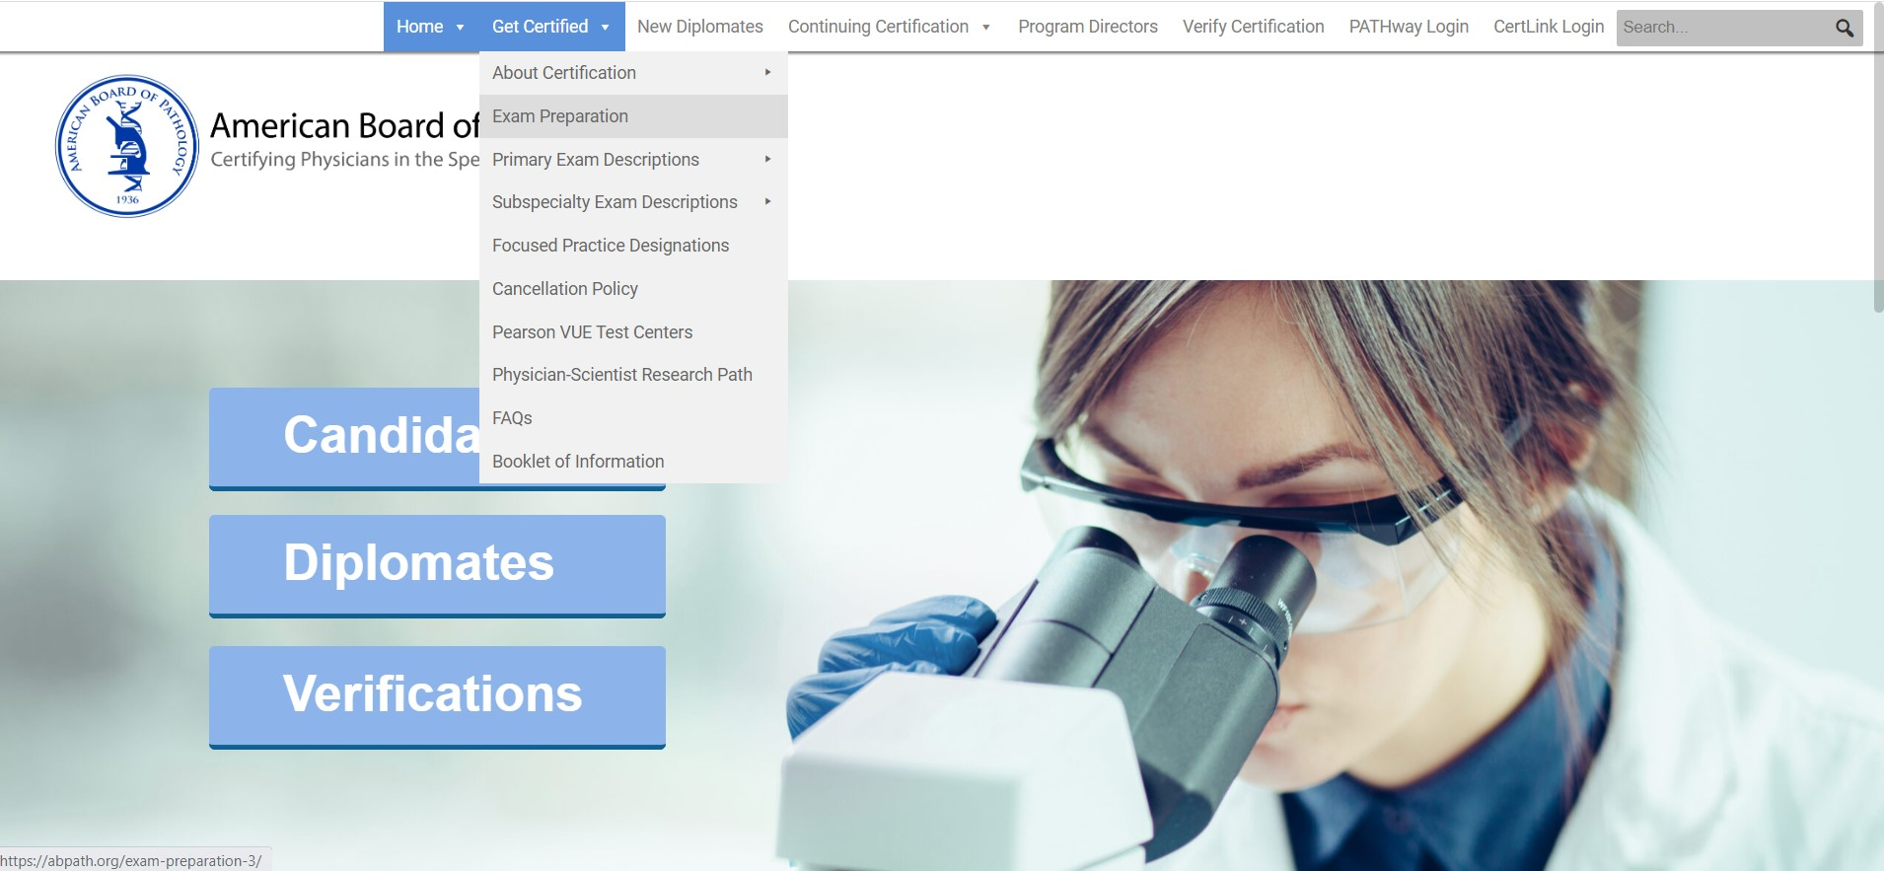
Exam Resources abpath.org
Exam Dates, Deadlines and Fees
Exam Blueprints and Exam Descriptions
Practice Tutorial
Virtual Microscopy Practice

Slide 26
ABPath Resources
www.abpath.org website
Booklet of Information- the complete guide for certification requirements
Mary@abpath.org for Primary Certification
Renee@abpath.org for Subspecialty Certification
PATHway

Slide 27




Follow us on social media!
@theABPath

